Slide 1

License Plate Recognition System With Speech Recognition Feature and GUI Platform

Slide 2
Student’s Information
Abrar Islam (ID - 160021017)
Abdullah Al Mehadi (ID - 160021025)

Slide 3
Introduction
Control of vehicles is becoming a big problem
AVI systems are used for purpose of effective control
LPR is an image processing technology used to identify vehicles using only their license plate
Integration of voice recognition system provides extra layer of security for the owner.

Slide 4

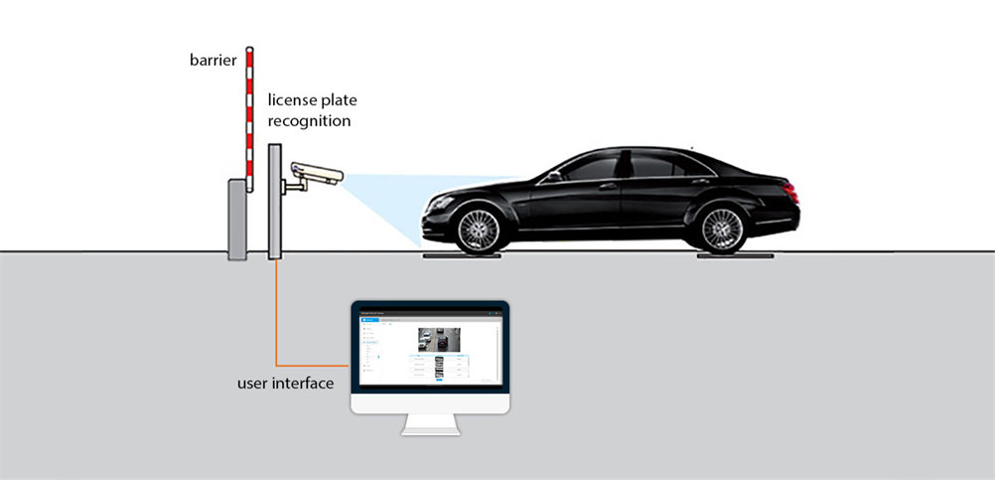
Objective
Use of correlation function to detect number plates.
Use of Neuron Network to recognize voice.

Slide 5
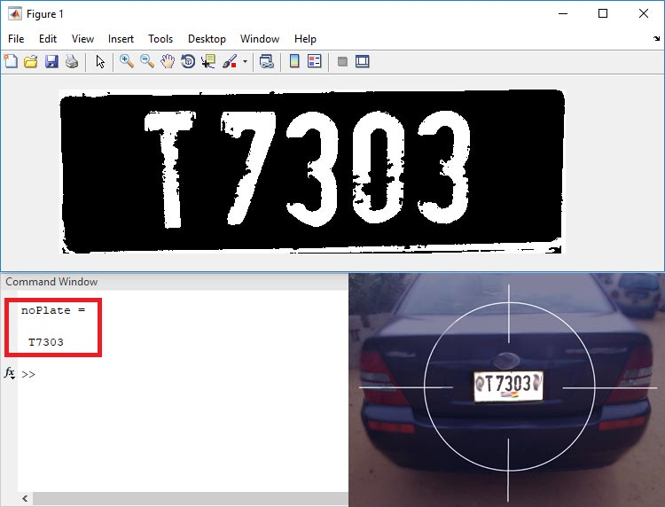
Methodology for number plate detection

Slide 6
Methodology for number plate detection
Template Creation- This is used to call the saved images of alphanumerics and then save them as a new template in MATLAB memory. This works as training set.
Letter Detection – Reads the characters from the input image and find the highest matched corresponding alphanumeric.
Plate Detection – Process the image and then call the above two m-files to detect the number.

Slide 7
Template Creation
A preset image of every character is uploaded and saved in the library
This image is then used for comparison of input image.

Slide 8
Letter detection
Letters are segmented
Alphanumeric output of input image are given
Resized the input image so that it can be compared with input image
Correlation with every image in the template is done
A matrix is created to record the value of correlation for each alphanumeric template with the characters template from the input image,

Slide 9
Plate detection
Detects the area of interest (plate) from the whole picture
Crops the rest of the part
Image is converted to suitable format
Image is converted to gray scale
Image processing is done
Edge detection is done

Slide 10
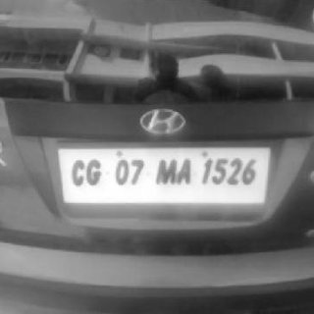
Grey scale image

Slide 11
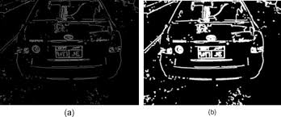
Edge detection

Slide 12
Voice recognition
Used Neural Network for the operation.
Neural Network with two layers.
Used the sigmoid activation function.
Used 1600 training set.
Used 21 features.
Used the recognition to input an image.

Slide 13
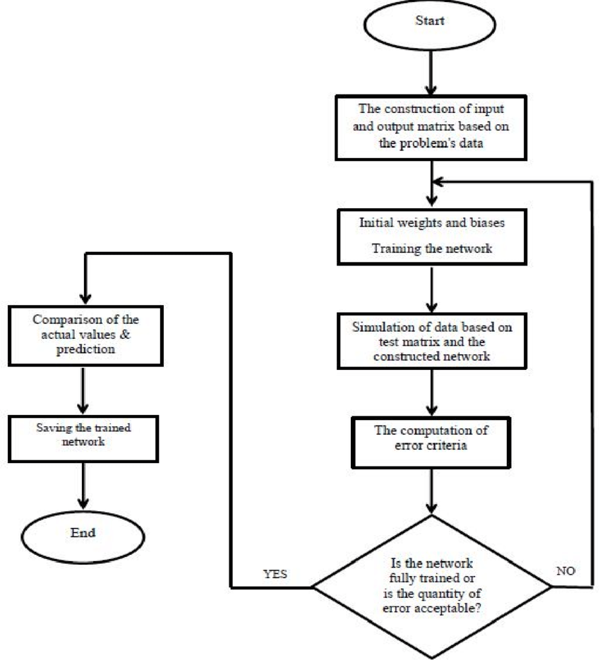
Methodology

Slide 14
Steps in order
Creating Data - First created the data by recording(800 examples).
Creating Input – Using the data created input and data synthesizing was used(1600 ex.).
Feature Extraction – Auto correlation was used.(20 features) .
Final Algorithm – Neural network(2 layers).
Final prediction – Using the trained value, prediction was done.
Finally used a GUI platform to represent the project.

Slide 15
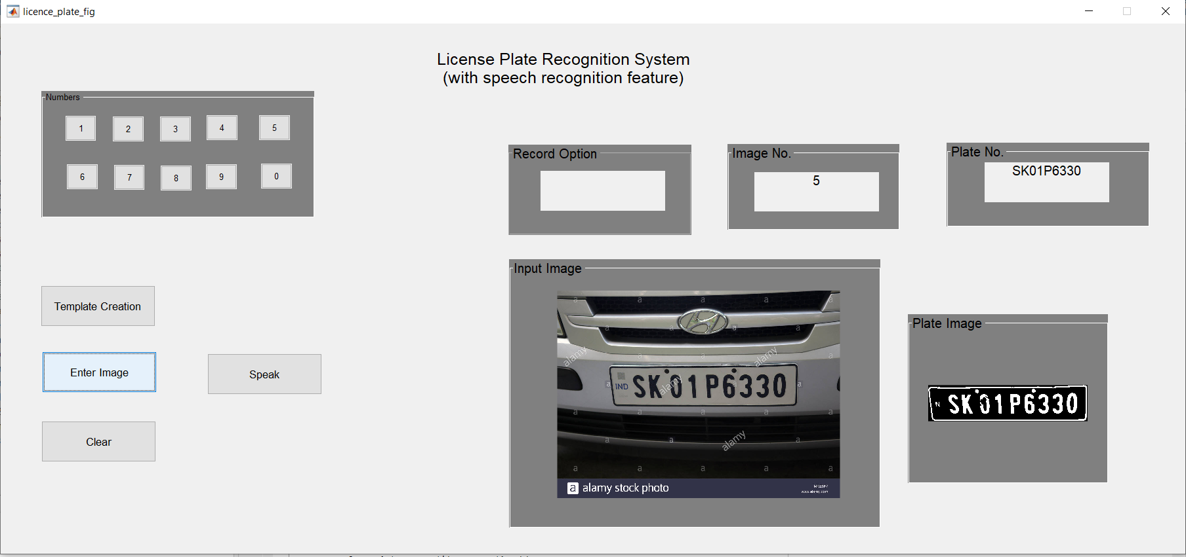
Gui Representation

Slide 16
Conclusion
Using correlation to detect license plate was a success.
However, it can not detect plates for moving vehicle or slight blur photo.
Voice recognition was a greater success as Neural Network was used.
It can also recognize the numbers from other people’s voice .
Further future, optimistic about developing both of the operation using CNN and RNN.

